Slide 1

AKS Office Hours
Kendall Roden
Cloud Native Technical Specialist
Kendal Roden
Cloud Native Technical Specialist
Dave Strebel
Cloud Native Technical Specialist

Slide 2
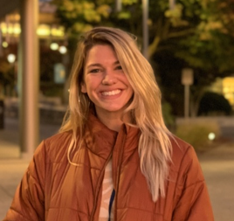
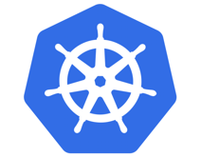


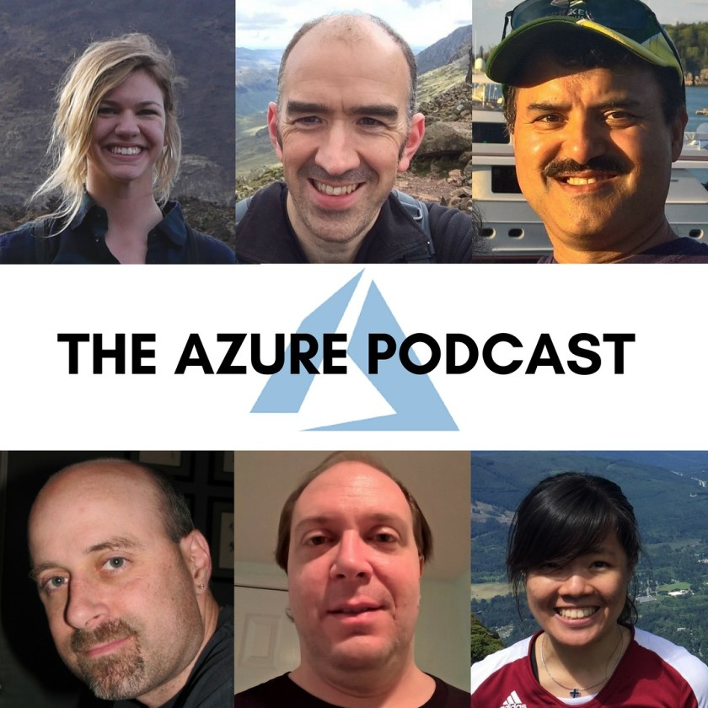

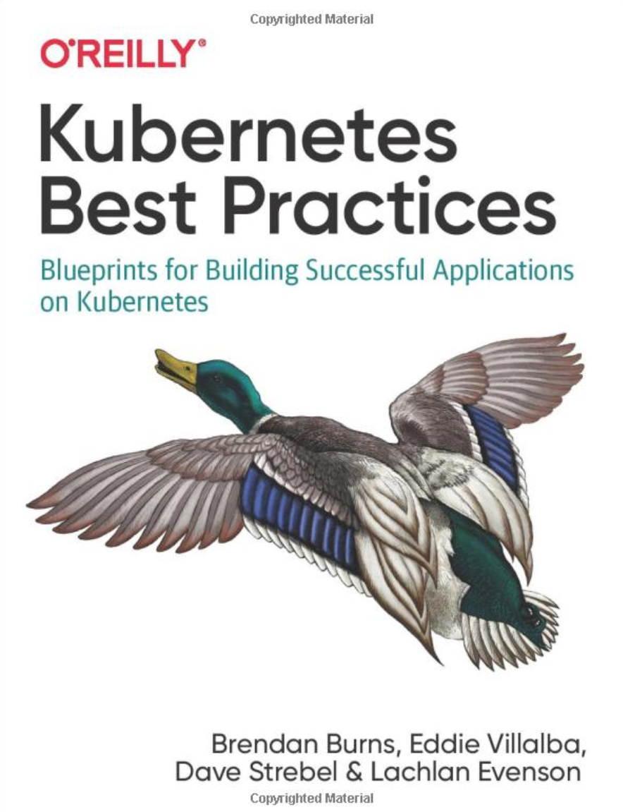
Who are we?
@kendallroden​
@dave_strebel​

Slide 3
Why AKS Office Hours?
Provide AKS customers with updates pertaining to AKS and the Cloud Native Ecosystem
Host a short talk and/or demo on Cloud Native technologies related to Kubernetes and AKS
Collect feedback from customers on issues, blockers, use cases, and questions related to AKS

Slide 4
What to expect
Keep in mind
We want two-way interaction, but please stay on mute when you are not speaking
Office hours are hosted primarily by the GBB team, with the support of the PG
Recordings and content will be available post-call, barring any technical difficulties
Contact us with thoughts, ideas or questions (aksofficehours@microsoft.com)

Slide 5

AKS Updates

Slide 6
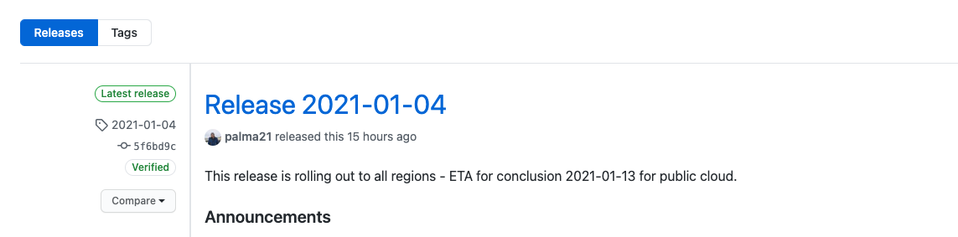
AKS Release Notes
Announcements:
Pod security policy (preview) feature retirement = May 31st, 2021
Once GA, AKS will default to its new GPU specialized image
1.16.x clusters cannot be created post Jan 31st – returning to typical support cycle
Notes:
GPU Specialized Image: https://docs.microsoft.com/en-us/azure/aks/gpu-cluster#use-the-aks-specialized-gpu-image-preview
Tranparent vs Bridge mode: https://docs.microsoft.com/en-us/azure/aks/faq#what-is-azure-cni-transparent-mode-vs-bridge-mode

Slide 7
Quick rundown on PSP and GPU Specialized Image
Pod Security Policies (PSP)
PSP was enabled in k8s to limit what pods could be deployed (read up here)
Replacement = using Azure Policy for AKS to secure pods
Azure Policy Add-on for AKS installs a managed instance of Gatekeeper
Azure Policy for K8s is built on top of the Open Policy Agent
GPU Specialized Image
Deployment of a DaemonSet for the NVIDIA device plugin is currently required before GPUs in GPU-enabled nodes can be used
GPU specialized image already contains the NVIDIA device plugin for Kubernetes
Can be done on existing cluster with GPU capability or at creation time

Slide 8
AKS and related Azure updates
AKS now supports every CPU-based SKU dynamically
GPU and other specialty SKUs still require additional validation before being enabled
AKS Cluster Auto-Scaler now exposes the max-node-provision-time and priority properties as part of the Cluster Auto-Scaler profile (Learn more)
Support for ACR across Availability Zones is now in Public Preview
AzMon for Containers support for Private Clusters now in Public Preview

Slide 9
Ecosystem Updates

Slide 10
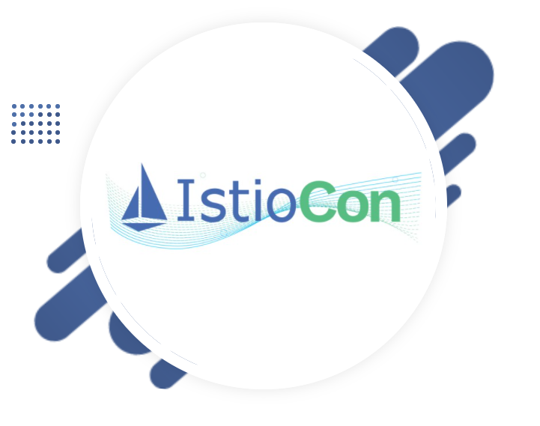
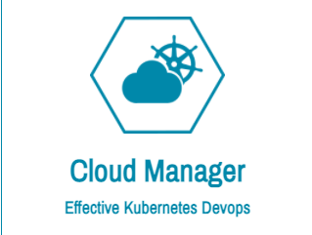
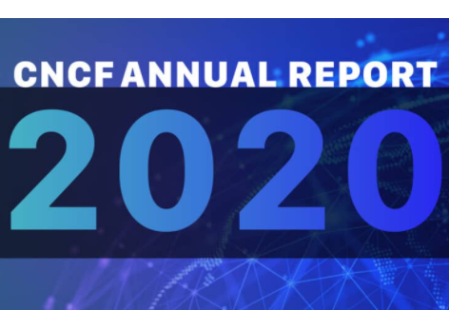



Open Source and Ecosystem call outs
IstioCon 2021
CFP closes Jan 18th
Schedule announced Jan 25th
Held Feb 21-25
Cloud Manager: A new multicloud PaaS platform build on K8s
CNCF Annual Report Available
In 2020, 5 CNCF-hosted projects advanced to graduated
CKS Study Guide
RedHat buys StackRox
Another note on Docker deprecation in Kubernetes
What MIGHT break?
Think about Windows containers

Slide 11
Quick reference: KubeCon 2020 content overload
Everything You Should Be Doing, But Aren’t: DevSecOps for K8s Workflows - Steven Terrana & Dan Papandrea
Notary v2: Redesigning the Secure Supply Chain for Containers - Justin Cormack & Steve Lasker
A High-Schooler’s Guide to Kubernetes Network Observability -Drew Ripberger
Kubernetes CronJobs - Does Anyone Actually Use This [in Production]? - Kevin Yan
Stop Writing Operators - Joe Thompson
…others?
Notes:
- DevSecOps for K8s, sysdig. Really good overview. Covers app dependency scanning, static code analysis, container image scanning, and how to do this on kubernetes
-Notary v2: Supply Chain Security. Notary v1 was s docker project and since then there has been a lot of collaboration around it for v2. It essentially allows you as the container publisher to digitally sign collections and configure trusted publishers. Similar offering in ACR Content Trust and when you are pulling a signed docker image from ACR you are actually using the same library as the Notary CLI uses to validate the signature. Note ACR does not officially support the Notary CLI however but its compatible with some of its APIs
-A High-Schooler’s Guide to Kubernetes Network Observability – actually by a highschooler, he is in university now talks about the project kube-netc but also goes through some really good basics of Networking observability in a cluster,
K8s cronjobs: does anyone actually use this-Kevin is from Lyft, lots of cronjobs. Getting into some problems around distributed scheduling and pokes holes in the the cronjob object.
(1) Stop Writing Operators - Joe Thompson, talks a lot about when to use/not use the operator pattern. Theres beena lot of momentum around the number of k8s operators that have been popping up

Slide 12
Thank you! Join us for our next call in 2 weeks!

